Slide 1
Regular Expressions

Slide 2
Equivalence of FA and RE
Finite Automata and Regular Expressions are equivalent. To show this:
  Show that a DFA can express as an equivalent RE
  Show that a RE can express as an ε-NFA. Since the ε-NFA can be converted to a NFA and the NFA to an DFA, then RE will be equivalent to all the automata we have described.

Slide 3
Turning a DFA into a RE
Theorem: If L=L(A) for some DFA A, then there is a regular expression R such that L=L(R).
Proof
  State Elimination
    We’ll see how to do this next, easier than inductive construction, there is no exponential number of expressions

Slide 4
DFA to RE: State Elimination
Eliminates states of the automaton and replaces the edges with regular expressions that includes the behavior of the eliminated states.
Eventually we get down to the situation with just a start and final node, and this is easy to express as a RE

Slide 5
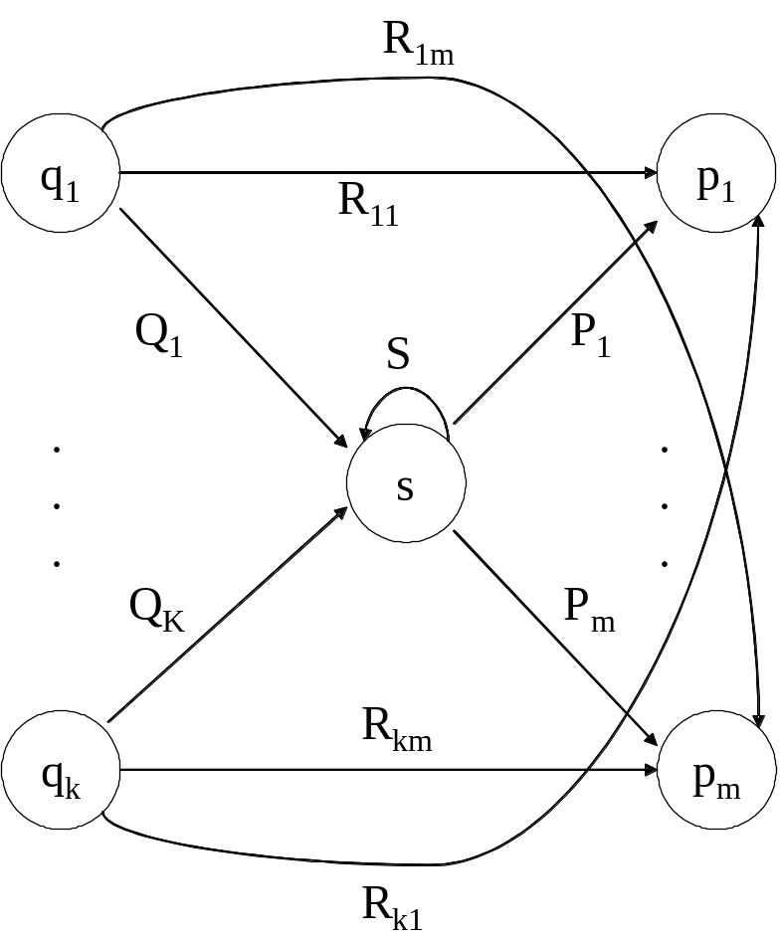
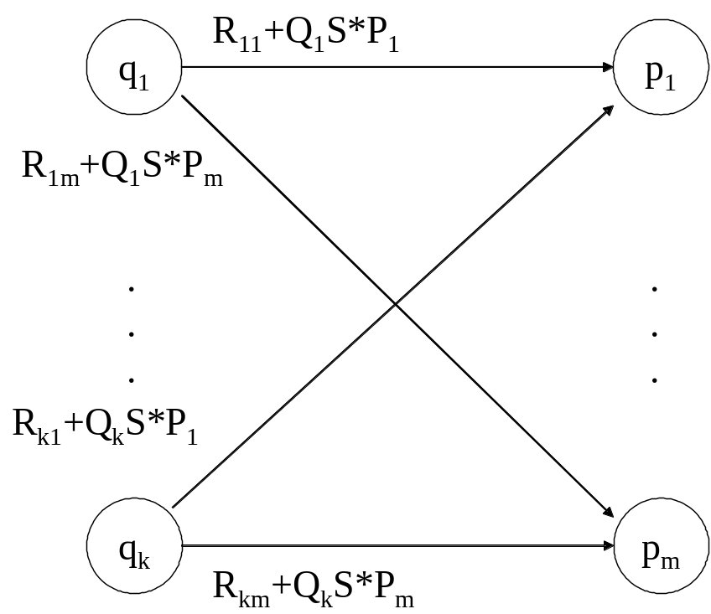
State Elimination
Consider the figure below, which shows a generic state s about to be eliminated. The labels on all edges are regular expressions.
To remove s, we must make labels from each q_{i} to p₁ up to p_{m} that include the paths we could have made through s.
Note: q and p may be the same state!

Slide 6
DFA to RE via State Elimination (1)
Starting with intermediate states and then moving to accepting states, apply the state elimination process to produce an equivalent automaton with regular expression labels on the edges.
  The result will be a one or two state automaton with a start state and accepting state.

Slide 7
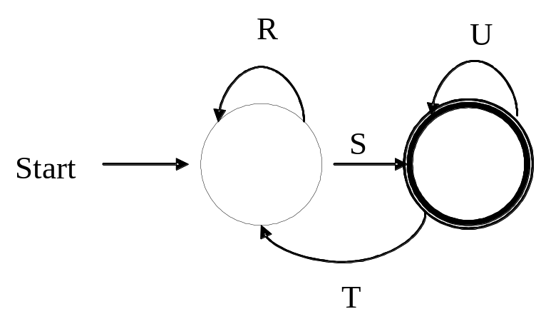
DFA to RE State Elimination (2)
If the two states are different, we will have an automaton that looks like the following:
We can describe this automaton as: (R+SU*T)*SU*

Slide 8
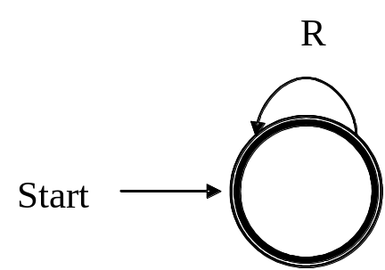
DFA to RE State Elimination (3)
If the start state is also an accepting state, then we must also perform a state elimination from the original automaton that gets rid of every state but the start state. This leaves the following:
We can describe this automaton as simply R*.

Slide 9
DFA to RE State Elimination (4)
If there are n accepting states, we must repeat the above steps for each accepting states to get n different regular expressions, R₁, R₂, … R_{n}. For each repeat we turn any other accepting state to non-accepting. The desired regular expression for the automaton is then the union of each of the n regular expressions: R₁∪ R₂… ∪ R_{N}

Slide 10
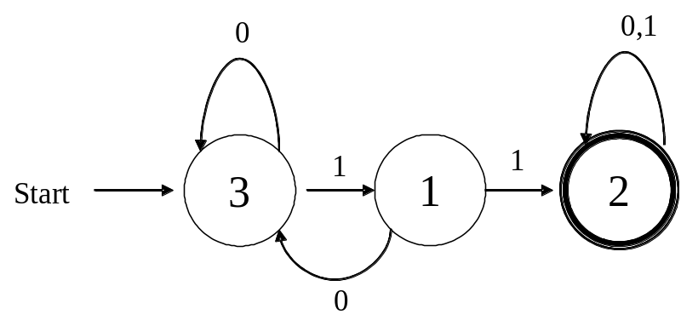
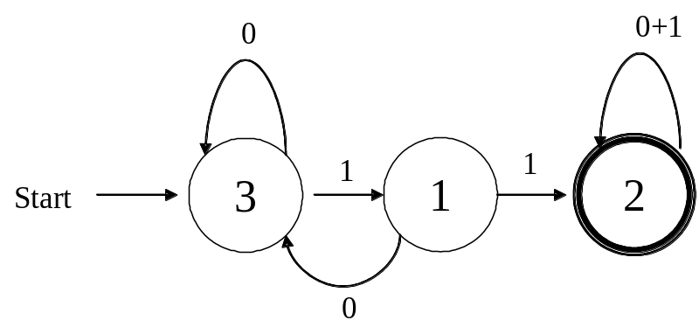
DFA→RE Example
Convert the following to a RE
First convert the edges to RE’s:

Slide 11
DFA → RE Example (2)
0
0+1
Eliminate State 1:
To:
3
1
1
1
2
Start
0
0+10
0+1
Note edge from 3→3
3
11
2
Start
Answer: (0+10)*11(0+1)*

Slide 12
Second Example
Automata that accepts even number of 1’s
Eliminate state 2:
0
0
0
1
1
2
1
3
Start
1
0+10*1
0
1
10*1
3
Start

Slide 13
Second Example (2)
0
0+10*1
1
10*1
3
Start
Two accepting states, turn off state 3 first
0
0+10*1
1
10*1
3
Start
This is just 0*; can ignore going to state 3 since we would “die”

Slide 14
Second Example (3)
0
0+10*1
1
10*1
3
Start
Turn off state 1 second:
0
0+10*1
1
10*1
3
This is just 0*10*1(0+10*1)*
Combine from previous slide to get 0* + 0*10*1(0+10*1)*
Start

Slide 15
Converting a RE to an Automata
We have shown we can convert an automata to a RE. To show equivalence we must also go the other direction, convert a RE to an automaton.
We can do this easiest by converting a RE to an ε-NFA
  Inductive construction
  Start with a simple basis, use that to build more complex parts of the NFA

Slide 16
RE to ε-NFA
Basis:
R=a
a
R=ε
ε
R=Ø
Next slide: More complex RE’s

Slide 17
S
ε
ε
R=S+T
ε
T
ε
S
ε
T
R=ST
ε
ε
S
ε
R=S*
ε

Slide 18
RE to ε-NFA Example
Convert R= (ab+a)* to an NFA
  We proceed in stages, starting from simple elements and working our way up
a
a
b
b
a
ε
b
ab

Slide 19
RE to ε-NFA Example (2)
ab+a
a
ε
b
ε
ε
ε
a
ε
ε
(ab+a)*
a
ε
b
ε
ε
ε
ε
ε
a
ε
ε

Slide 20
What have we shown?
Regular expressions and finite state automata are really two different ways of expressing the same thing.
In some cases you may find it easier to start with one and move to the other
  E.g., the language of an even number of one’s is typically easier to design as a NFA or DFA and then convert it to a RE

Slide 21
Algebraic Laws for RE’s
Just like we have an algebra for arithmetic, we also have an algebra for regular expressions.
  While there are some similarities to arithmetic algebra, it is a bit different with regular expressions.

Slide 22
Algebra for RE’s
Commutative law for union:
  L + M = M + L
Associative law for union:
  (L + M) + N = L + (M + N)
Associative law for concatenation:
  (LM)N = L(MN)
Note that there is no commutative law for concatenation, i.e. LM ≠ ML

Slide 23
Algebra for RE’s (2)
The identity for union is:
  L + Ø = Ø + L = L
The identity for concatenation is:
  Lε = εL = L
The annihilator for concatenation is:
  ØL = LØ = Ø
Left distributive law:
  L(M + N) = LM + LN
Right distributive law:
  (M + N)L = LM + LN
Idempotent law:
  L + L = L

Slide 24
Laws Involving Closure
(L*)* = L*
  i.e. closing an already closed expression does not change the language
Ø* = ε
ε* = ε
L⁺ = LL* = L*L
  more of a definition than a law
L* = L⁺ + ε
L? = ε + L
  more of a definition than a law

Slide 25
Checking a Law
Suppose we are told that the law
  (R + S)* = (R*S*)*
holds for regular expressions. How would we check that this claim is true?
1. Convert the RE’s to DFA’s and minimize the DFA’s to see if they are equivalent (we’ll cover minimization later)
2. We can use the “concretization” test:
  Think of R and S as if they were single symbols, rather than placeholders for languages, i.e., R = {0} and S = {1}.
  Test whether the law holds under the concrete symbols. If so, then this is a true law, and if not then the law is false.

Slide 26
Concretization Test
For our example
  (R + S)* = (R*S*)*
We can substitute 0 for R and 1 for S.
The left side is clearly any sequence of 0's and 1's. The right side also denotes any string of 0's and 1's, since 0 and 1 are each in L(0*1*).

Slide 27
Concretization Test
NOTE: extensions of the test beyond regular expressions may fail.
Consider the “law” L ∩ M ∩ N = L ∩ M.
This is clearly false
  Let L=M={a} and N=Ø. {a} ≠ Ø.
  But if L={a} and M = {b} and N={c} then
  L∩M does equal L ∩ M ∩ N which is empty.
  The test would say this law is true, but it is not because we are applying the test beyond regular expressions.
We’ll see soon various languages that do not have corresponding regular expressions.

